Slide 1

SilcoTek® Coatings
F-TM-001 rev A

Slide 2
Outline
Brief history
Coatings overview
Our process
Benefits
SilcoNert vs. Dursan
Applications

Slide 3

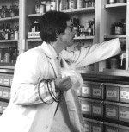
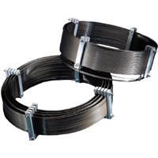
Brief History
invents SilcoSteel® in 1987 to make stainless steel capillary columns act like glass
Paul Silvis – Founder of Restek® and SilcoTek®. Current President of SilcoTek.

Slide 4
Throughout the 1990s, a team dedicated to the SilcoSteel® technology began to experiment with custom coating for various uses.
Demand grew for coatings outside of chromatography applications.
2009: Restek coatings group splits off and forms SilcoTek®, an independent company

Slide 5
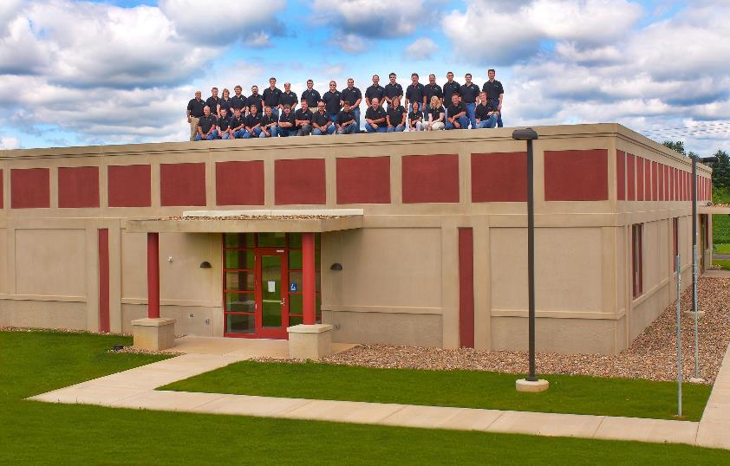
2013: 3,400 m² state-of-the-art coating facility opens, tripling previous coating capacity

Slide 6

Where are we?

Slide 7
Our Business
Strategies:
Coatings that Expand Material Limits
Protect the technology
Make our coatings accessible worldwide
Business Models:
Coating service
Technology licensing company

Slide 8
What are SilcoTek Coatings?

Slide 9
What are SilcoTek Coatings?
Barrier coatings- prevent chemical interaction with the surface of a part
  Inertness, corrosion resistance, etc.
Why?
  → Improve the surface properties of preferred base materials e.g. stainless steel

Slide 10
SilcoTek’s Coating Process

Slide 11


1. Receipt and Inspection

Slide 12
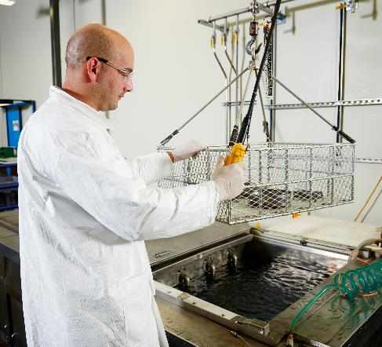
2. Surface Preparation

Slide 13
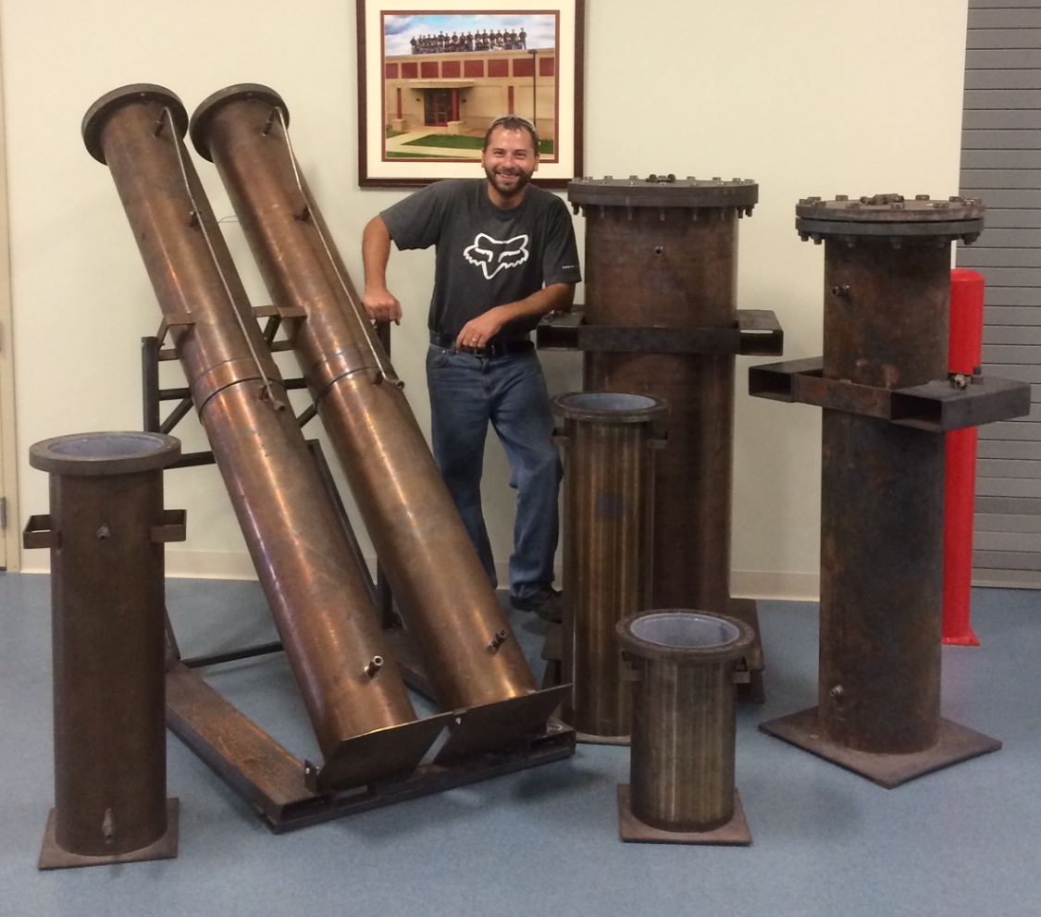
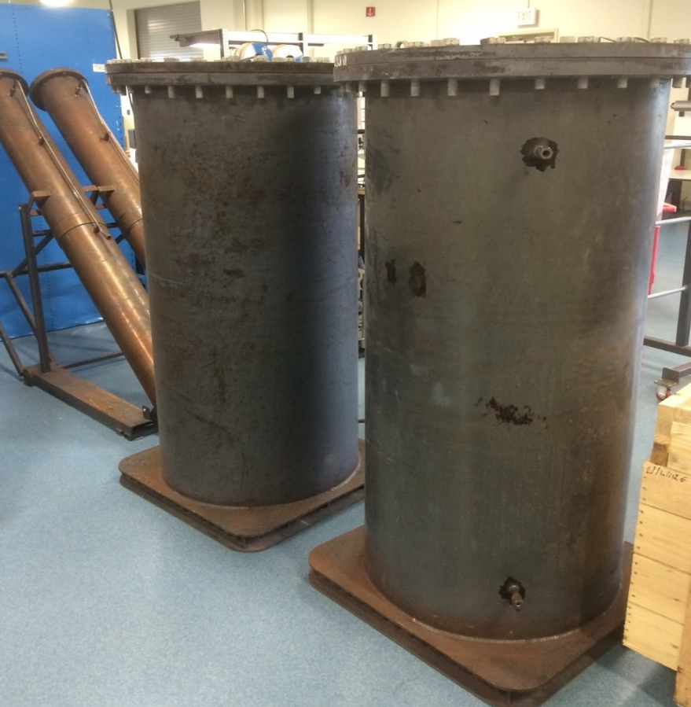
3. Vessel Loading
Largest current size: 1.63m x .76m ID

Slide 14
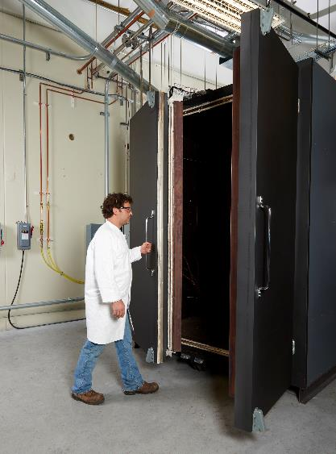
4. Oven Loading and Coating

Slide 15
The Coating
Process
R
R
R
- Si -
- Si -
-
-
R
- Si -
- Si -
-
- Si -
-
-
R
R
- Si -
R
-
-
-
- Si -
R
-
R
-
R
-
R
-
- Si -
-
R
-
- Si -
-
R
-
R
R
R
- Si -
R
-
-
- Si -
R
-
-
- Si -
Gas
Supply
-
-
- Si -
- Si -
-
-
- Si -
-
-
-
- Si -
- Si -
-
-
-
- Si -
-
-
-
- Si -
-
- Si -
-
-
-
-
- Si -
- Si -
-
-
- Si -
150-1600nm
-
-
-
-
-
-
Processing Chamber (vacuum)
Part to be coated

Slide 16
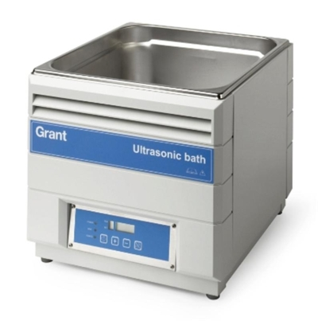
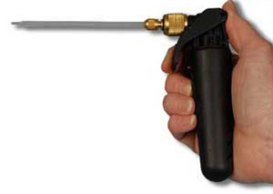
5. Post-Clean

Slide 17
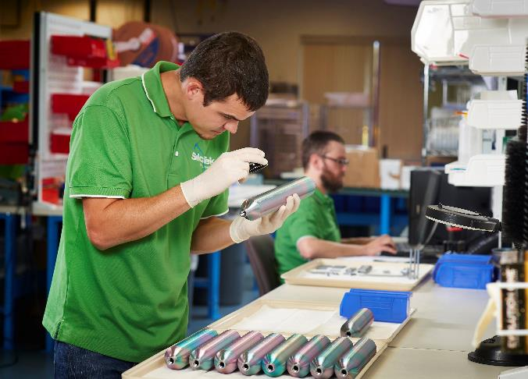
6. QC

Slide 18


7. Packaging and Shipping

Slide 19
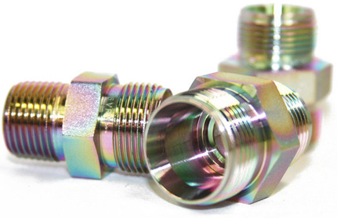
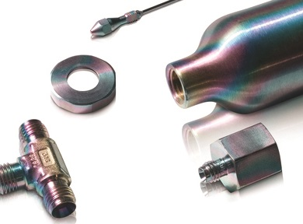
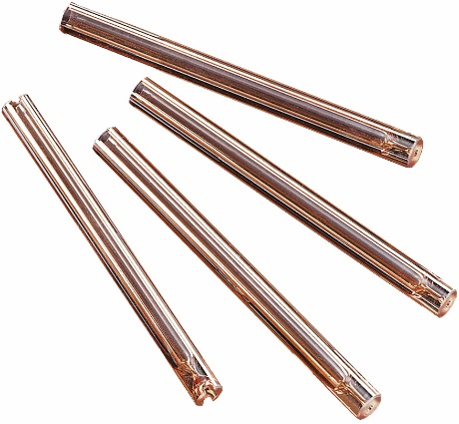
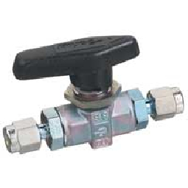
Chemical Vapor Deposition

Slide 20
Market Driven Focus
  Process systems
    Sampling for stacks in coal plants, monitoring chemical streams (ABB, Siemens, Emerson)
  Analytical
    Instrument providers (Shimadzu, ThermoFisher, etc.) and associated accessories (Restek)
  Gas & Oil
    Sampling and refining equipment (Schlumberger, Exxon, Shell)
  Semiconductor
    OEM Etch and Deposition applications
  Aero/Automotive
    Anti-coking applications

Slide 21
2020 Goals
100 Patent Applications
  Protect our intellectual property
  Core to our corporate value and stability
10 Off-Sites
  Better serve high volume customers
  Improved logistics (time and $)
$100 million in Revenue​

Slide 22
SilcoTek Z I P Code
Zero Disappointmens​
  We deliver innovative coatings that provide unique solutions that significantly enhance the lifetime and performance of our customer’s parts. ​
  We coat thousands of parts perfectly every day, year after year by using robust scalable systems ​
  We never blame our customers, we look in the mirror! ​
Integrity in all we do​
  Integrity in coating performance, properties, & customer solutions ​
  Integrity with customer, vendor, banking, financing, all interactions!​
Plus 1™ Service
  Customers love doing business with SilcoTek!​
  We go the extra mile to exceed customer needs​ and expectations
  We make our customers smile!​

Slide 23
Non-negotiable Core Values of a SilcoTek Employee
FISHING!​
Fast Failure = Fast learning​
In the Light = Team work and Trust ​
Servant Leadership = We care about each other.​
Honesty = We are open, trustworthy, do what we say we are going to do​
Innovation = if we don’t innovate, we die.​
Never stop learning = Growth and personal achievement is a priority​
Give it all you got = Work hard and play hard!​

Slide 24
Coating Properties
Coating customer-supplied parts with silicon (Si)-based treatments provide desired surface properties that aren’t achievable with common materials.
These properties can be summarized in three ways:

Slide 25
1. Non-Reactivity (Inertness)
For measuring highly active molecules e.g. sulfurs, mercury, ammonia, etc.
To eliminate the unwanted effects from stainless steels, other alloys, glass, and ceramics; reaction with the process stream

Slide 26
2. Corrosion Resistance
Coatings on stainless steel perform similarly to exotic materials e.g. Hastelloy® in several common process environments:
    HCl
    H₂SO₄
    Sea water, and many more

Slide 27
3. Low Surface Energy
Anti-sticking
Easy cleaning
Hydrophobicity
Anti-coking / anti-fouling

Slide 28
Why?
Increase system uptime – eliminate delays and detect upsets sooner
Increase lifetime
Comply with regulations and standards
Save money

Slide 29
Common Applications
• LNG/CNG sampling and testing | • Process monitoring
• Air emissions analysis | • Chemical manufacturing
• Power generation (coal-fired) | • Odorant sampling
• Refinery, flare, and flue gas | • HCl streams
• NOx and SOx | • H₂S
• Mercury | • Ammonia slip
• Automotive | • Moisture analyzers
• Research (reactors, vacuum, etc.) | • Subpart –Ja, EPA 325, Tier 3

Slide 30
Examples of Parts We Coat*
• Valves | • Fittings
• Sample cylinders | • Transfer tubing
• Regulators | • Filters
• Quick connects | • Frits, discs and screens
• Probes | • Injectors
• Inlet and headspace systems | • Gas chromatograph flow paths
• Chambers and reactors | • Custom fabrications
* Assemblies (valves, regulators, etc.) must be completely taken apart before sending to SilcoTek

Slide 31
Benefits

Slide 32
Benefits: Inertness
A more durable, higher temperature alternative to Teflon®
Get the most reliable analyzer results more quickly

Slide 33
Benefits: Inertness
Required for accurate quantification of sulfurs, mercury, or other highly active molecules at low levels
Faster and more reliable analyzer performance

Slide 34
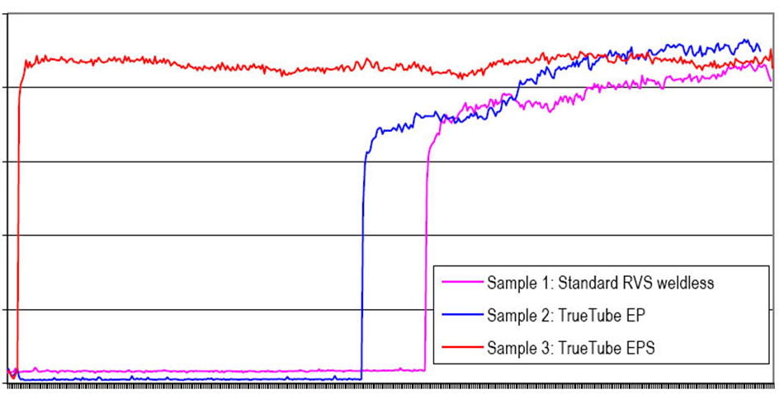
Barrier Stops Reactivity
Methyl Mercaptan (CH₃SH) Recovery
2.5
2.0
1.5
CH₃SH Response (millions of counts)
1.0
316SS welded and drawn tube
0.5
Electropolished 316SS tube
0.5 ppmv
CH₃SH in helium
Silco’d + EP 316SS tube
25
50
75
100
125
150
Retention Time (min)
*Data courtesy of Shell Research Technology Centre, Amsterdam

Slide 35
Inertness
  SilcoNert ® 2000 improves storage of H2S & Mercaptans
    Reduces adsorption effects
    Improves analytical reliability
    Increased accuracy
      17ppbv H₂S Containment in 500ml Cylinders
Notes:
Another example of the benefits of this coating can be seen in the storage time of sulfur compounds.
Swagelok® sample cylinders are commonly used in refineries to sample streams that contain levels of H2S which must be measured accurately.
If a non-coated cylinder is used, the refinery must immediately test the sample cylinder or the results will not be accurate. When a SilcoNert® coated Swagelok® sample cylinder is used by the refinery, the sample can sit days before analysis with no negative effect. Another industry seeing growing demand for sulfur testing is the natural gas market. Trace levels of mercury in these wells accumulate over time and eventually begin to damage pumping equipment.
Besides sulfur, SilcoNert® offers benefits in the analysis of other components as well; most notably mercury(Hg) or mercuric oxides.
Just as sulfur does, mercury adsorbs to metal and cannot be measured with accuracy and reliability.
Increasing government regulations on the amount of mercury that is allowed to be emitted from coal fired boilers in the power generation industry make this an ideal market to focus on. Besides power generators, the stack monitoring contractors, installers and actual manufacturers of the analytical testing equipment see a need for SilcoNert®.
The chemical stability of SilcoNert® 2000 treated Swagelok sample cylinders give the customers flexibility, stability and assurance that they will get the right result every time.

Slide 36
Benefits: Corrosion Resistance
Extend life of process equipment
Drastically cut costs related to exotic materials and part replacement
Keep the versatility and ease of using stainless steel

Slide 37
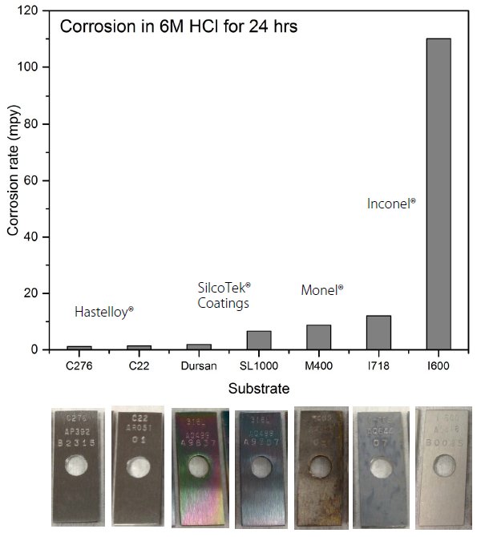
Coatings vs. High Performance Alloys
ASTM G31
Guidelines

Slide 38
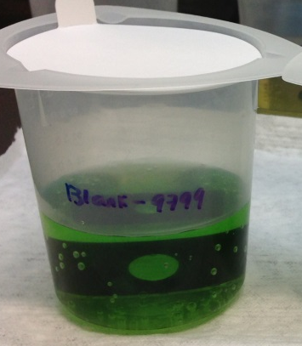
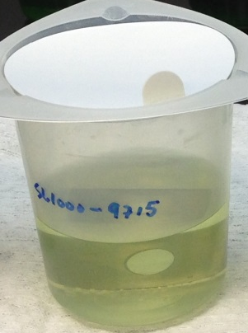
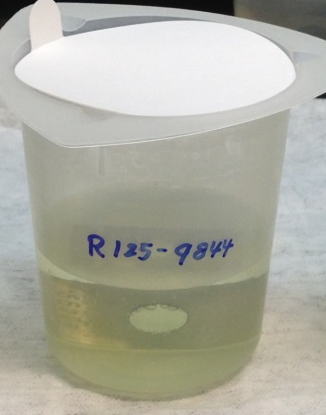
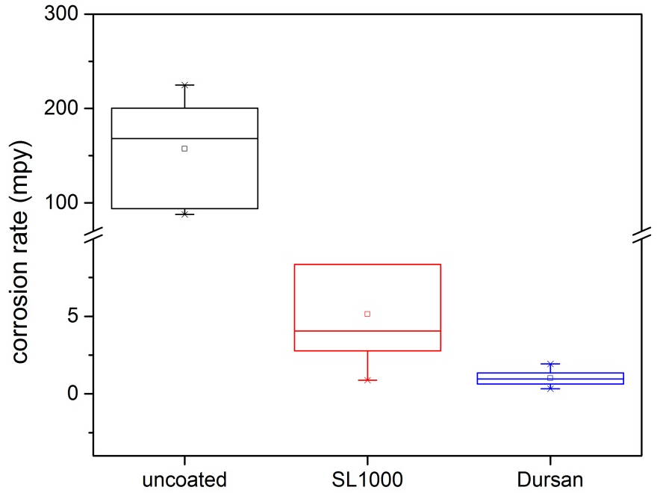
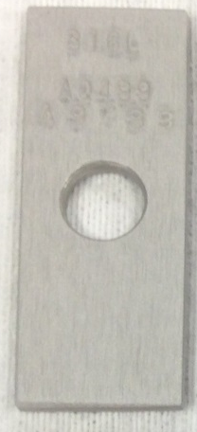
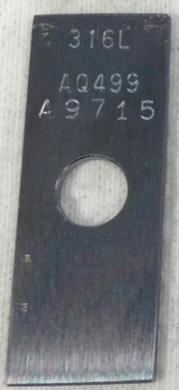

HCl at room temperature – stable protection
Solution of uncoated coupon turned green after a 24-hour immersion in 6M HCl; solutions of coated coupons showed very slight color changes.
Both SL1000 and Dursan provide good protection under this condition, with Dursan slightly outperforming Silcolloy.
uncoated SL1000-coated Dursan-coated

Slide 39
Benefits: Low Surface Energy
Reduce negative effects from moisture
Make surfaces easier to clean and less likely to retain particulate
Improve efficiency (think of motor oil ads)

Slide 40
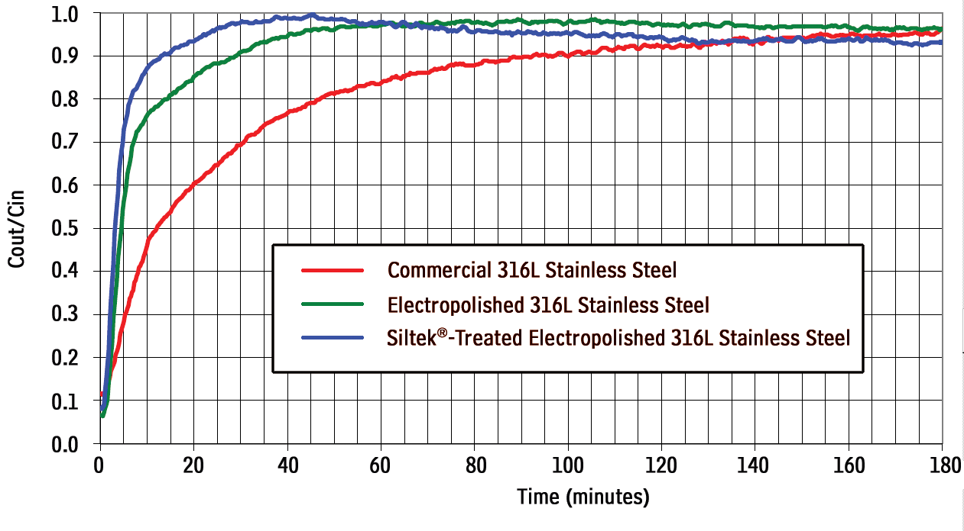
50% faster response

Slide 41
How to Recommend Coatings

Slide 42


SilcoTek’s Primary Coatings
(a.k.a. Sulfinert®)

Slide 43
Auger Depth Profile: Silco-
_{Diffusion}
_{Zone}
100
90
Silicon
80
70
60
Iron
Atomic Concentration (%)
50
40
30
20
Cr
10
Oxygen
Ni
0
Mo
500
1000
1500
2000
2500
3000
Sputter Depth (Å )

Slide 44
Auger Depth Profile: Dursan
100
90
80
70
Fe
60
Atomic Concentration (%)
50
Si
40
O
30
20
C
Cr
10
Ni
0
S
0
500
1000
1500
2000
2500
3000
3500
4000
4500
5000
Sputter Depth (Å )

Slide 45
(Sulfinert)
An upgrade to Teflon®
The most inert coating, best for measurement
Ideal in benign analytical environments

Slide 46
The go-to for corrosion resistance
Only coating suitable for full pH 0-14
  All Silco- coatings limited to pH<8
Also abrasion resistant for moving parts
The “low surface energy” coating

Slide 47
Still inert enough for most analytical applications (low ppm analysis)
Good with sulfurs, not with mercury
Much still to be tested from inertness perspective

Slide 48
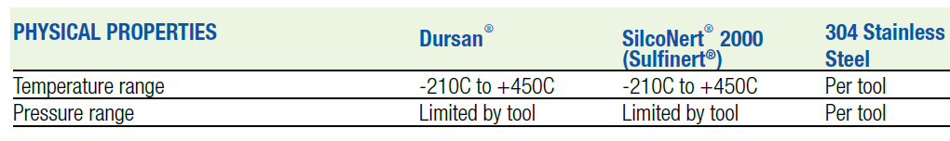
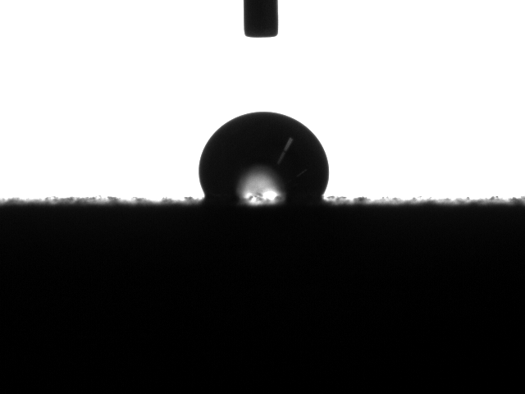
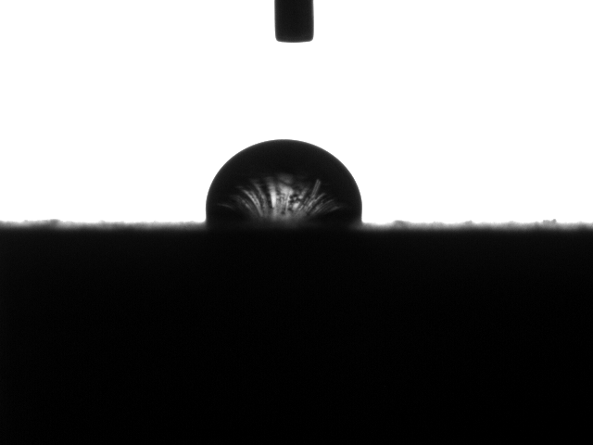

Dursan and SilcoNert 2000
Physical Comparison
Hydrophobicity
(contact angle on 120 grit; 58 rms SS coupons)
121°
101°
36°

Slide 49
When to Use Dursan® vs. when to use SilcoNert®

Slide 50
Analytical and Sampling :
Challenge | Dursan® | SilcoNert® | Bare SS
Moisture | ü | ü
Acids | ü | ü
Bases | ü
Slow signals, bad peaks, etc. | ü | ü
H₂S, NO_{x}, SO_{x}, etc. (≥ ppm level) | ü | ü
H₂S, NO_{x}, SO_{x}, etc. (≤ ppm level) |  | ü
Hg and NH₃ |  | ü

Slide 51
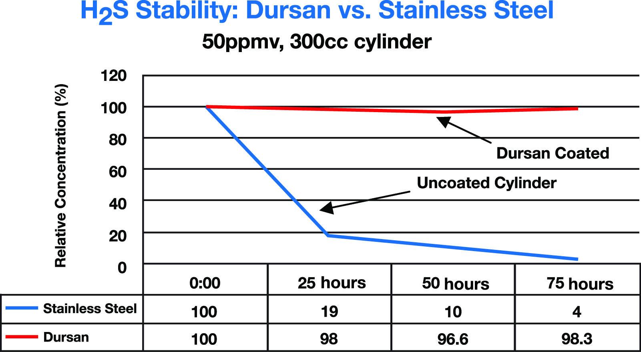
Dursan provides stable inertness for reliable analysis, even days after sampling

Slide 52
How to Recommend:
Analytical and Sampling
SilcoNert 2000 (Sulfinert) is still the most inert coating we offer and is the only option for applications with:
  Ammonia
  Mercury
  Anything at sub-ppm levels

Slide 53
How to Recommend:
Analytical and Sampling
However, Dursan provides a more robust surface that is inert enough for most sampling applications and is the only coating that can withstand:
  Bases/caustics
  Abrasion
  Corrosive media that degrade stainless steel

Slide 54
Corrosion:
Challenge | Dursan® | Silcolloy® | Improvement over bare SS
HCl* | ü | ü | 160x
15% Bleach* | ü |  | 17x
25% H₂SO₄* | ü |  | 11x
Salt Spray | ü |  | Unlimited
Galvanic Corrosion | ü |  | 90x
Chlorides, Pitting | ü |  | 9x
HF |  |  | Marginal
High concentration H₂S (> ~3%) |  |  | Marginal
*Reflects room temperature testing after 24hr immersion.

Slide 55
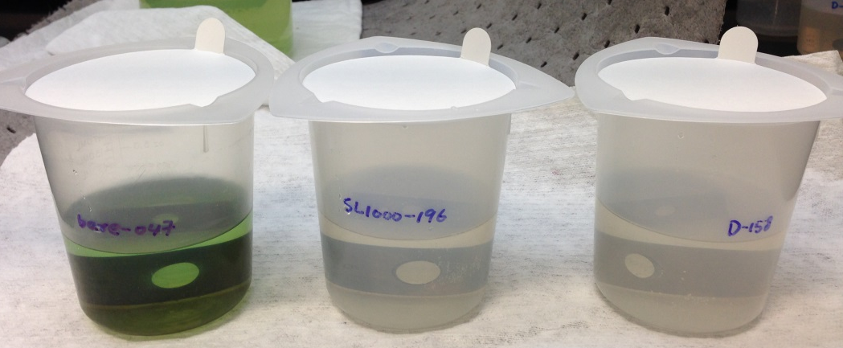
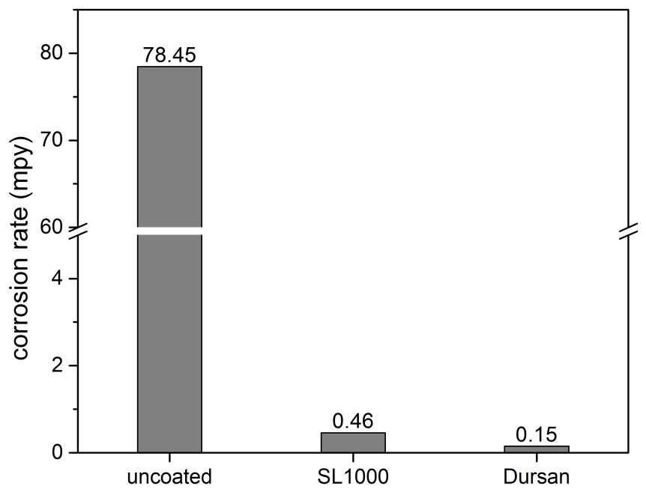
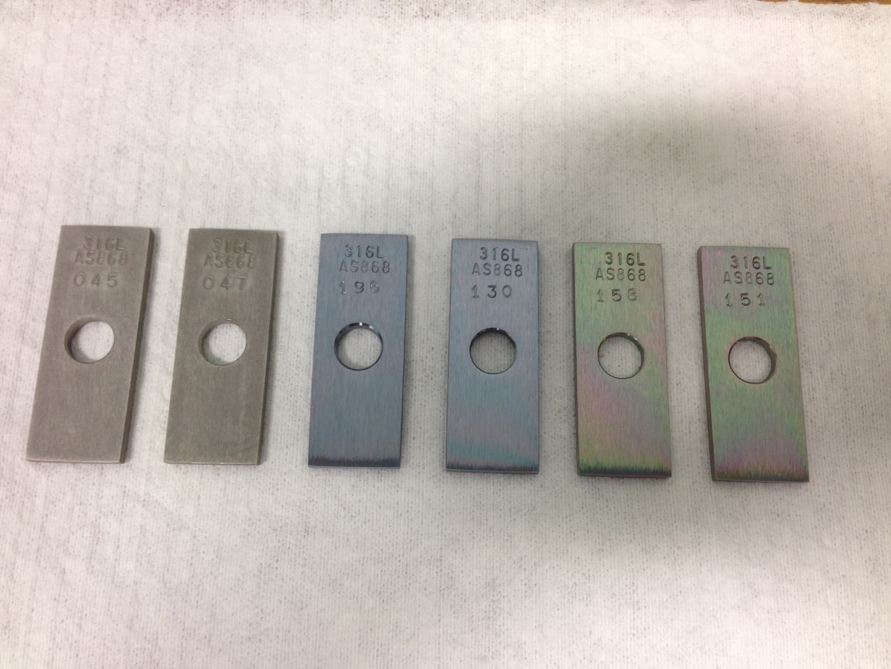

Sulfuric Acid 85% - 24hr
uncoated SL1000-coated Dursan-coated

Slide 56
How to Recommend:
Corrosion
Current solutions are Dursan or Silcolloy (usually Dursan)
Our data provide a broad foundation for understanding the coatings’ capabilities
Always test coatings in the corrosive application
Consult SilcoTek and work together on a testing plan to optimize coating and material selection

Slide 57
Advanced Surface Properties:
Challenge | Dursan® | Silco- Coatings | Bare SS
Hydrophobicity | ü
Easier cleaning | ü
Non-stick | ü
Anti-Fouling | ü
Temperatures >450° C |  | ü | ü

Slide 58
Dursan resists water, increasing component lifetime and improving performance
Rough
Coupons
SN 1000
49°
SN 2000
101°
Dursan
121°
Rough: 120 grit; 58 rms (µin.)
Smooth: mirror-like #8; 10 rms (µin.)

Slide 59
How to Recommend:
Advanced Surface Properties
Always Dursan for anything involving “sticking”, hydrophobicity, varnishing, difficult cleaning, etc. at or below 450° C
Silicon coatings (SilcoNert 1000, Silcolloy, SilcoGuard, SilcoKlean) are the only options when exceeding 450° C
SilcoKlean is specially designed for preventing carbon build-up (also known as “coking”)

Slide 60
Applications

Slide 61
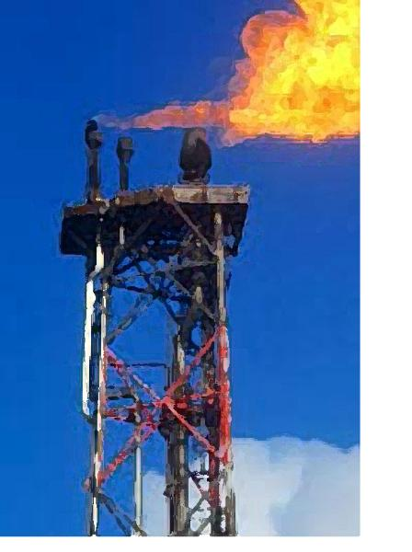
Applications
Subpart –Ja, refinery flare gas testing
Oil and gas well down-hole sampling
Ethylene/Propylene catalyst poisons
Coal fired boiler flue gas testing
Ammonia slip
Automotive
H₂S to SO₂ conversion above 100°C
Tier 3 fuel standards

Slide 62
Flare testing: Sulfurs, Mercury, Ammonia
40 CFR 60 Subpart –Ja regulation
  All new and modified refinery flares to be monitored by November 2015
Given stream compositions, inert coatings will aid with trace level analysis of total sulfurs
Stream may even have HF from Phillips Alkylation units

Slide 63
Flare testing: Sulfurs, Mercury, Ammonia
Davidson, et. al.⁴ published data on refinery flare gas monitoring systems performance over 1 year
Monitoring range from 1 to 150,000 ppm total sulfur
Vent gas measure at middle 50% of flare with angled coated probe to get representative sample
Highlighted importance of stable instrumentation, heated sample system and inert coating to entire sample pathway

Slide 64

Flare testing: Sulfurs, Mercury, Ammonia
Lessons applied to Subpart –Ja demand
Sample system stability:
  Heated transfer lines
  Surface finish considerations
  Metallurgy
  HF or no HF
Can achieve the regulatory standards and provide stable performance

Slide 65
Well Sampling: Mercury and Sulfur
Need to quantify sulfur and mercury content of wells
Any level of mercury (measured in µg/m³) is of interest because of mass volumes being pumped
Presentation by Schlumberger in 2007¹ and 2013⁵ highlight the application of coatings to create stable sample bottles.

Slide 66
Well Sampling: Mercury and Sulfur
Conclusions:
  Mercury necessitates clean handling and inert sample bottle or risk losing all mercury to adsorption
  Sulfur results dependent on system design down-hole and of sample bottle conditions and composition on surface
  Even 50ppm levels of Sulfur unstable in transfer unless coatings used to address adsorption created by metallurgy

Slide 67
Well Sampling: Mercury and Sulfur
Harfoushian conducted direct coated versus non-coated study using downhole sampling reservoirs
Sample loaded into sample reservoirs with a certified concentration of 50µg/m³ mercury
5000psi sample pressure
Sample reservoir kept at 100°C

Slide 68
Well Sampling: Mercury and Sulfur
Uncoated Sample reservoir experienced complete loss of mercury after 60 minutes
No loss of mercury in SilcoNert-coated sample reservoir during study time of 210 minutes

Slide 69
Ethylene/Propylene: Trace Sulfur
Study presented by Biela, et. al. from Equistar and Air Liquide⁶
Sulfur contamination causes catalysis poisoning which directly impacts yield
H₂S (hydrogen sulfide) and COS (carbonyl sulfide) coming over in polymer-grade Ethylene and Propylene
Conversion of COS in furnace to H₂S and then contact with catalysts.

Slide 70
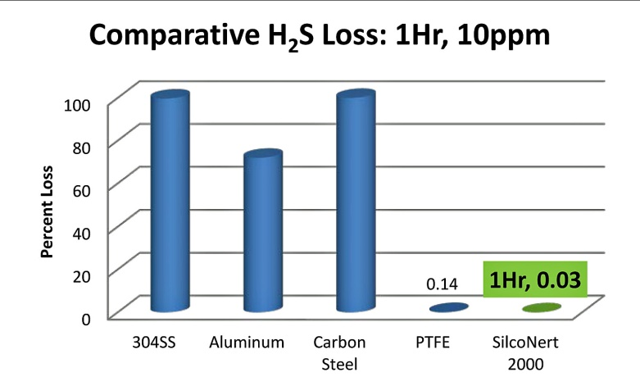
Ethylene/Propylene: Trace Sulfur
Poison levels very low (Propylene)
  10ppb COS
  50ppb CS₂
  1ppm Dimethyl Sulfide (DMS)
  Manufacturing Specifications for monomers:
      50ppb H₂S (ethylene); 20ppb COS (propylene)
  Inert Sampling systems and standards are necessary for monitoring low level impurities in order to keep catalyst conversion yields high

Slide 71
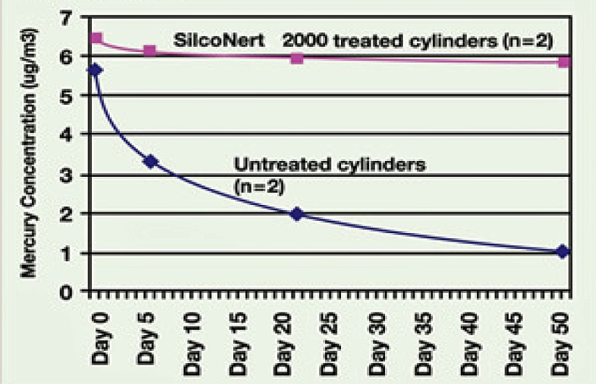
Flue Gas
Emissions of mercury in coal flue gas from boilers is now a monitored pollutant. Also effluent from refining/petro activities that are monitored
    Problem is the oxidation of mercury
    and inability to analyze due to loss.
  Elemental converted to HgCl2; HgBr2 (easier to scrub using carbon based adsorbents)
  Studies done on oxidized mercury Hg²⁺ demonstrate 100% transfer of these adsorptive compounds in coated transfer lines⁷.

Slide 72
Ammonia
Ammonia slip is release of ammonia through treatment process and pollution control equipment.
Necessary to accurately monitor the levels of ammonia.
Studies demonstrate surface roughness and use of inert materials or coatings greatly impacts ammonia transfer efficiency.

Slide 73
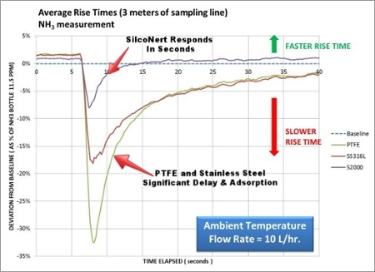
Reducing Adsorption of Ammonia
32% less response with a PTFE tubing flow path
18% less with a stainless steel flow path
8% less with SilcoNert-coated flow path
Bertrand S. Lanher, PhD., Sensors, Inc. 2016

Slide 74
NO_{x} compounds
Common pollutant from combustion process
Monitoring for boilers and automotive need to look at NO_{x} emissions.
Mixed samples of NO_{x} compounds along with ammonia and moisture common for automotive exhaust = very difficult application
Silco-based coating performing as well as PTFE-lined with no adsorption, change or loss⁹

Slide 75
H₂S Conversion above 100°C
H₂S decomposing on hot stainless steel as demonstrated by Biela, et. al.⁶ and Reese, et. al.¹⁰
Mechanism presented by Reese.
  Oxidation to SO₂ above 100°C in contact with Stainless steel
Biela demonstrated complete loss of H₂S, 100ppb, at temperatures above 100°C
Biela demonstrated when inert coating applied over stainless steel, H₂S loss is eliminated. Testing conducted from 50°C to 225°C
¹⁰ Reese, G.; Mason, A.; Cuthbert, D.,”A Novel Solution for the Analysis of Speciated Sulfurs and Nitriles in Various Hydrocarbon Streams”; Gulf Coast Conference, Galveston, TX, Paper 36 (2014)

Slide 76

Tier 3 Fuel Standards
Sulfur in Gasoline from 30ppm to 10ppm starting 2017
Old tricks of priming sample system will not work
Common sources of sulfur adsorption:
  Probes
  Tubing
  Metal filters
  Sample Cylinders
  Regulators
  Fittings
  Valves
Get testing systems ready now.

Slide 77
Summary – Why SilcoTek?
Get faster, more reliable analytical results that you can trust
Save money with parts that last longer
Use preferred base materials, but get the surface properties required for the application

Slide 78
Collaboration
Consider SilcoTek your “coating consultants”
Very flexible with visits and creating custom sales/marketing materials
Coatings give our partners differentiation and upsell opportunities

Slide 79
Resources
Overview Brochure (hard copies for you)
FAQs
Material Compatibility Guide
Coating Care Guide
Process Overview
Blog, whitepapers, application notes, and a lot more: www.SilcoTek.com

Slide 80
Questions?

Slide 81
Thank you!
For quotes or tech. service:
SilcoD@SilcoTek.com or (814) 353-1778

