Slide 1
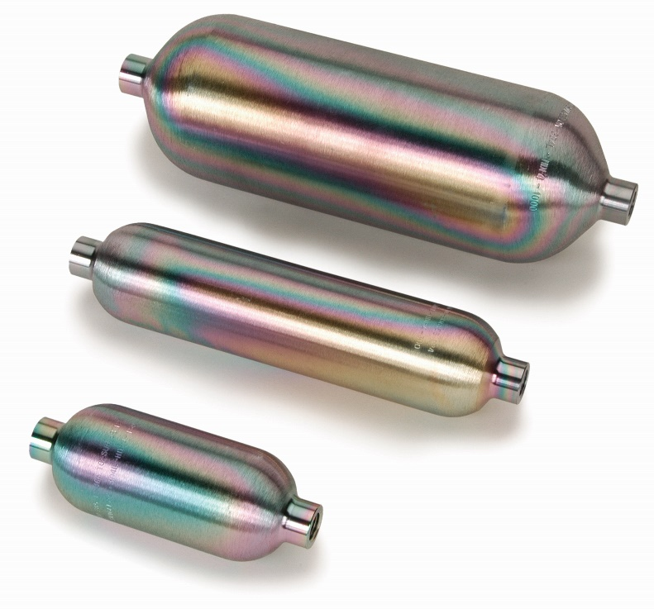
Welcome to the Webinar!
A Step-by-Step Guide to SilcoTek® Coating Care
Your
Presenter:
Gary Barone
Gary is SilcoTek’s Business Unit Manager in charge of sales, marketing, and engineering efforts.
Today, he will give you expert tips and best practices for proper care and maintenance of SilcoTek-coated products, helping you achieve peak performance for longer usable life.
We will begin 2 minutes past the hour
F-TM-001 rev A

Slide 2
Welcome!
Webinar will be recorded and emailed to you
You can find it any time on SilcoTek.com
#AskSilcoTek on Twitter (@SilcoTek)
?
Send questions via message bar

Slide 3
What We’ll Cover
A general overview inspection and proper cleaning techniques
Application-specific tips
Do’s and don’ts of SilcoTek coating care

Slide 4
Your Presenter: Gary Barone
B.S. Chemical Engineering; MBA
R&D with Restek since ’90
Been working on coatings since ’94 from R&D/Tech. Service/Marketing/Sales

Slide 5
Introduction
SilcoTek coatings are rugged, durable and are used in a lot of applications
Performance will be impacted by contamination and poor environment
Good news: Performance can be maintained if not completely restored

Slide 6
Coating Care Tips

Slide 7
Can I bend the coating?
Yes – SilcoTek coatings can be flexed without cracking or flaking
Be careful not to expose new, uncoated surface area (especially in analytical applications)
Minimum bend radius of 16x OD of tubing is recommended

Slide 8
Flexibility Demo Video
Notes:
Tube bending video

Slide 9
Nuts and Ferrules
Nuts and ferrules should not be coated
Nuts are not in the flow path, coated ferrules have potential to leak
A proper connection will ensure minimal active surface area on ferrules

Slide 10
Welding
SilcoTek can produce a good coating on TIG and MIG welds, or vacuum nickel brazes
Welding after coating will remove the coating ~4mm from the heat affected zone

Slide 11
Do’s and Don’ts of SilcoTek Coating Care

Slide 12
Do’s and Don’ts
Don’t use basic solutions or soaps with pH > 8
SilcoNert, Silcolloy, etc. will be damaged
Dursan OK with bases, should still avoid

Slide 13
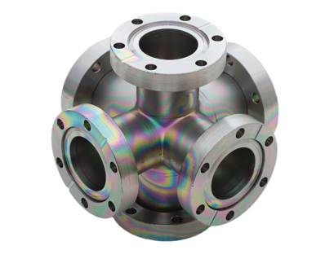
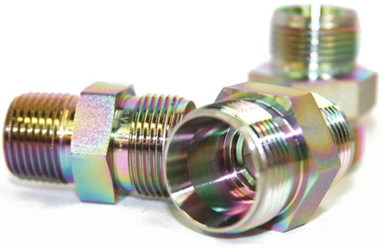
Do’s and Don’ts
Do clean as part of regular maintenance
Contaminants can accumulate and lead to issues, especially in analytical applications

Slide 14
Do’s and Don’ts
Don’t steam clean a Silco- coating
Layer is not physically destroyed, but surface chemistry changes
Steam cleaning will drastically reduce inertness to active compounds

Slide 15
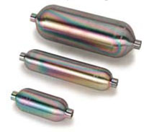
Do’s and Don’ts
Do send your treated parts in for re-coating as needed
We can strip the old coating, deposit a fresh one, and get your used parts back to peak performance without replacement

Slide 16
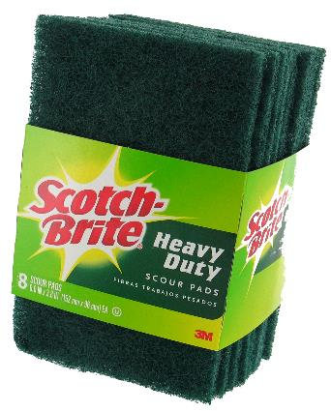
Do’s and Don’ts
Don’t abrade a SilcoTek coating
A Scotch-Brite™ pad with light hand pressure will remove Silco-coatings
Dursan is abrasion resistant, but still use caution

Slide 17
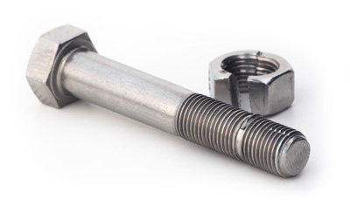
Do’s and Don’ts
Don’t let connections gall
Coated-on-coated connections can gall, or “cold weld,” parts together
Use PTFE tape or simply remove the coating from one of the threads

Slide 18
When to Clean

Slide 19
Some Indicators
Visual inspection clues
Declining/Poor analytical results
Process Upset in stream being sampled
Sitting on the shelf

Slide 20
Visual: The “rainbow?”
Color is indicative of thickness
Like oil on water
Colors can vary substantially even at nano-scale thickness variation

Slide 21
What if there’s no rainbow?
Is the coating the thick Silcolloy?
If not, possible loss of coating
Or if Dursan, it can visibly change during oil contamination
Change in appearance over time or vs new parts?
Visible Buildup tars/particles inside vs. outside?
Is one end different? Dark vs. light? Matte vs. glossy?
Localized areas of loss due to corrosion or wear?

Slide 22
Disappearing Coating

Slide 23
Cleaning 101

Slide 24
Why and How to Clean
Often used in field or process
Build up of inorganics and heavy organics cause problems
The SilcoTek coated components can be “new” again

Slide 25
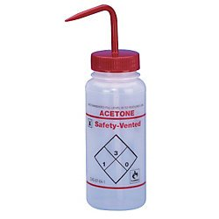
Cleaning Tips
Rinse with a solvent that will dissolve contaminants from the application
Nonpolar solvent for hydrocarbons
Polar solvent for more active contaminants

Slide 26
Cleaning Tips
Mild sonication is okay, but don’t over-sonicate
Solids can be removed with a soft nylon bristle brush using light pressure

Slide 27
Sonication Video

Slide 28
Cleaning Tips
Water based cleaning system
Use Neutral pH surfactants and detergents
Know what’s in off the shelf cleaners
Mild acidic cleaning at room temperature (except HF)
Do not use basic solutions or soaps with pH>8! rule

Slide 29
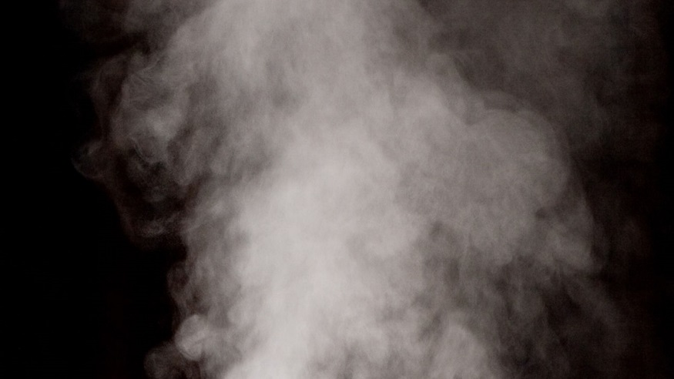
Cleaning Tips
Do not steam clean any SilcoTek-treated components!

Slide 30
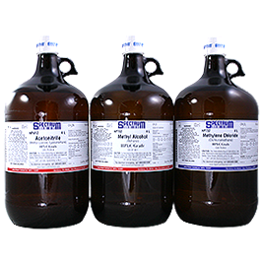
Cleaning Tips
Commonly recommended solvents
Acetone
Methanol/IPA
Dichloromethane
Water for inorganics and particulate

Slide 31
Application-Specific Tips

Slide 32
Every Challenge is different
Largest application uses:
Laboratory/Medical test equipment
Petro/Refining
Natural Gas/LNG
Stack Gas Sampling/CEMS
Semiconductor

Slide 33
Laboratory Equipment
Chromatographs, Diagnostic equipment
Often clean environment
non-volatiles or heavy organic buildup
Bake and purge with Nitrogen.
Solvent cleaning great for renewing

Slide 34
Petro/Refining
Sampling equipment and process analyzers
Heavy organics a problem
Particulate a problem
Upsets, could be anything

Slide 35
Petro/Refining
Use coated particulate filters!
Solvent cleaning, if can be done
If you get water use IPA, Acetone.
Do NOT use plant steam!

Slide 36
Natural Gas/LNG
Pipeline probes, sample cylinders, transfer tubing
Largest challenge is moisture and particulate
If samples taken near wall of pipeline, all kinds of possible contamination

Slide 37
Natural Gas/LNG
Use Filters!
Particulate
Water drop outs
If sample probes are showing particulate
wipe off with solvents
run through soft brushes with solvent
Water contamination; IPA, Acetone

Slide 38
Stack/CEMS
Very tough environment
Hot, acidic exhaust gases
Massive soot and particulate
Use filtration systems
Particulate can be cleaned from probes through wiping and soft brushing

Slide 39
Stack/CEMS
Inspect for corrosion
Inspect for coating loss
Primary attack areas will be outside of stack probe
If coating loss identified, re-coat

Slide 40
Semiconductor
Very clean environment, too clean
May require pre-install cleaning
Trace particulate possible
Source SemiCon approved Cleaning firms. Make sure they know the Do’s and Don’ts

Slide 41
Conclusion
Coatings will last a long time
Every application different, what is unique about yours?
Clean the dirt coating off the coating!
Measure of last resort, re-coat

Slide 42
Questions? Submit via the Webinar app., #AskSilcoTek on Twitter, or by emailing SilcoD@SilcoTek.com

Slide 43
Thank you!
E: SilcoD@SilcoTek.com | P: +1 (814) 353-1778
www.SilcoTek.com

